Slide 1
Study Unit 2 Data Types and Functions

Slide 2
Tuples

Slide 3
Define Tuples
A collection of values written as comma-separated items between a pair of round brackets.
Tuples are not specifically designed for mathematical operations.
A tuple is like a database record
Example: employee_A1 = ("Jimmy Chow", "Engineer", "Grade 2")
The items in a tuple can be numeric, string, or a mixture of both.
Useful when sharing data with others but not giving others the permission to edit the contents (aka, Immutable --- the contents cannot be changed)
tuple_name = (element1, element2, …)

Slide 4
Subset and Index Tuples
Use index operator [] to access specific elements in a tuple.
The index begins with 0 and ends with the number of elements minus 1.
To subset multiple elements, put the start and end indices, connected by a colon in the index operator.
Important: The end index is NOT included in the subsetting procedure.
Apply negative indices to access elements starting from the last element.
tuple_subset = tuple_name[start:end]

Slide 5
Example of index
Suppose we have a tuple of fruits, named as Fruits
We can index this tuple using a positive index
Alternatively, we can refer to elements of this tuple using a negative index
fruits = ("Apple", "Orange", "Banana")
fruits = ("Apple", "Orange", "Banana")
Index 0
Index 1
Index 2
fruits = ("Apple", "Orange", "Banana")
Index -3
Index -2
Index -1

Slide 6
Example of subset
Returning to our tuple named as ‘fruits’
Creating fruits_subset = fruits[0:2], obtain all elements except index 2
Create fruits_subset = fruits[-3:-1], obtain all elements except index -1
fruits = ("Apple", "Orange", "Banana")
fruits_subset = ("Apple", "Orange")
Index 0
Index 1
fruits_subset = ("Apple", "Orange")
fruits = ("Apple", "Orange", "Banana")
Index -3
Index -2
Index -1

Slide 7
Edit and Concatenate Tuples
Recall: Tuples are immutable.
Values of a tuple cannot be changed.
We are also not allowed to add a new value to an existing tuple.

Slide 8
Length of Tuples
The length of a tuple is the number of elements in it.
Use as an index to subset a tuple
Control the indexing so that the indices do not get out of range.
tuple_length = len(tuple_name)

Slide 9
For-Loops and Tuples
Tuple elements are can accessible by running a for-loop iteratively.
Put the name of the tuple in the for-statement directly.
It is also applicable to lists and dictionaries.
for counter in tuple_name:
instructions

Slide 10
Example Program for Students
Create two tuples: Tuple 1—The names of three people; Tuple 2—The ages of the three people
What are the length of Tuple 1 and Tuple 2, respectively?
Print the content in Tuple 1 and Tuple 2 with for loops, respectively.
Try to concatenate the two tuples.

Slide 11
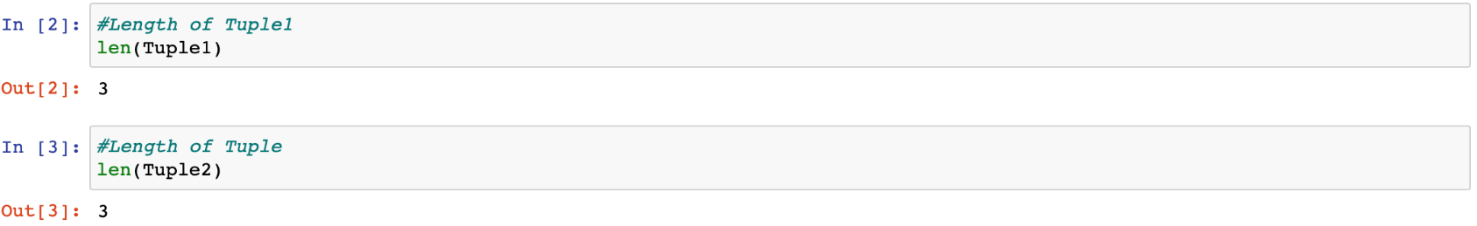
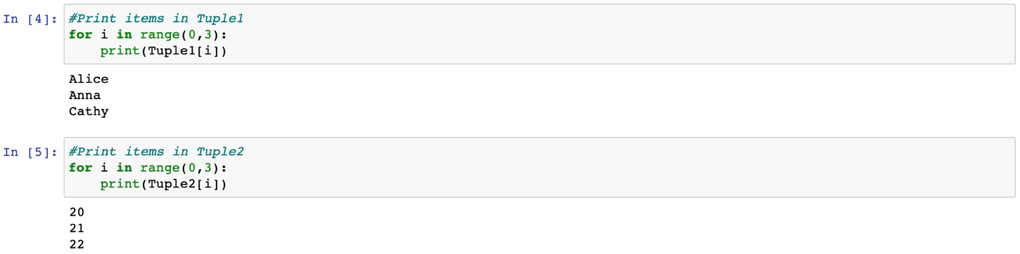
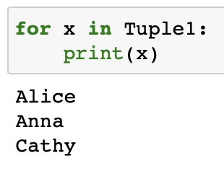
Example Program (Answers)
Create two tuples: Tuple 1—The names of three people; Tuple 2—The ages of the three people
What are the length of Tuple 1 and Tuple 2, respectively?
Print the content in Tuple 1 and Tuple 2 with for loops, respectively.
Try to concatenate the two tuples.

Slide 12
Lists

Slide 13
Create Lists
A Python list is just like a tuple with two main differences:
Data are comma-separated and wrapped by a pair of square brackets.
Content is modifiable.
We can construct a Python list in a similar fashion like a tuple.
The square brackets are not omittable.
Contents can be any type of objects: floats, integer, Booleans, strings, tuples, or even lists.
list_name = [element1, element2, …]

Slide 14
Subset Lists
Use index operator [] to access specific elements in a list.
All indexing and subsetting techniques for tuples are applicable to lists.
list_subset = list_name[start:end]

Slide 15
Modify Lists
Modify specific list items by subsetting and assigning new values to them.
Use multiple indexing to edit multiple items.
The list of new values will occupy the locations within [start index:end index] loactions on the left-hand side. The list on the left-hand side will expand or shrink accordingly.
list_name[index] = new value
list_name[start index:end index] = [list with new values]

Slide 16
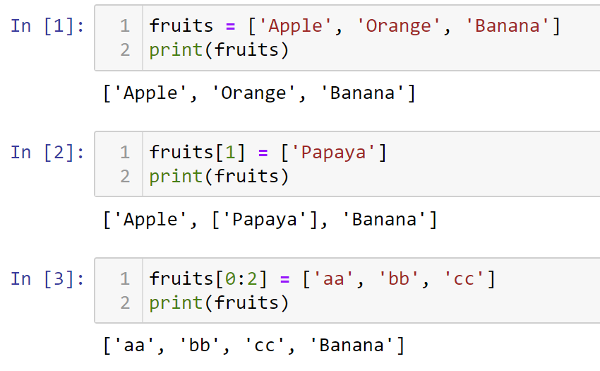
Examples of modifying lists
Index 0
Index 1
Index 2
Replacement
Replace & expand

Slide 17
Some subtle points
fruits[0:1] is a list ["Apple"]
To replace a list, we need a list
fruits[0:1] = ["Papaya"]
fruits[0] is a string, i.e., "Apple"
To replace a string, we need a string
fruits[0] = "Papaya"

Slide 18
Concatenate Lists
We can concatenate multiple lists into one by “adding” them together.
Addition operation “+” is used to concatenate objects such as string, tuples, or lists.
Concatenating lists is recommended if content and type of the lists are identical.
Even if the nature of the two lists is not identical, it is sometimes quite convenient to store the data in one list for later use.
combined_list = list1 + list2 + …

Slide 19
Example of concatenating lists
Suppose we have two lists, Fruits and Vegetables
Generate combined = fruits + vegetables
fruits = ["Apple", "Orange", "Banana"]
vegetables = ["Spinach", "Lettuce", "Cabbage"]
combined = ["Apple", "Orange", "Banana",
"Spinach", "Lettuce", "Cabbage"]

Slide 20
Merge Lists
Meaning and source of the elements in a concatenated list with different nature of data will become untraceable with time.
Merge two lists into a new list without combining the elements together.
Each element of the new list is a list and not a single value.
Define a new list by putting the list names as elements.
Use index to refer to a whole sub-list.
Possible to trace back the origin and meaning of the data in the new list.
list_name = [list1, list2, …]

Slide 21
Example of merging lists
Suppose we have two lists, Fruits and Vegetables
Now merge the two lists: combined = [fruits, vegetables]
fruits = ["Apple", "Orange", "Banana"]
vegetables = ["Spinach", "Lettuce", "Cabbage"]
1st element of combined is fruits
combined = [ ["Apple", "Orange", "Banana"],
["Spinach", "Lettuce", "Cabbage"] ]
2nd element of combined is vegetables

Slide 22
Print Lists
Use loops to subset lists and print the items to the screen.
Include lists in the for-statement to print the list items instead of using range().
for counter in list_name:
instructions

Slide 23
Enter Data to Lists
User-defined instead of pre-defined values for list items.
Let users enter their own data by the input() function.
Store the input into a list.
Do not limit the number of entries and use a while-loop with appropriate exit condition.

Slide 24
Example Program for Students
Create two lists: List 1—The names of three people; List 2—The ages of the three people
Modify the middle item in List 2.
Print the items in List 2 with for loop.
Concatenate the two lists.
Merge the two lists (including two sub-lists)

Slide 25
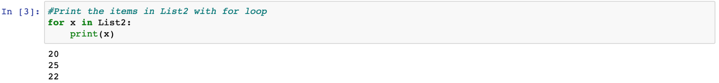
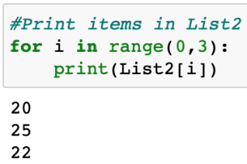
Example Program (Answers)
Create two lists: List 1—The names of three people; List 2—The ages of the three people
Modify the middle item in List 2.
Print the items in List 2 with for loop.
Concatenate the two lists.
Merge the two lists (including two sub-lists)

Slide 26
Dictionaries

Slide 27
Define and Access Dictionaries
A dictionary is an unordered set of key:value pairs.
The keys must be unique within one dictionary.
The key:value pairs are separated by commas and wrapped in a pair of braces.
Dictionaries are indexed by keys, which are usually strings or numbers.
Extract values in a dictionary by the keys.
dictionary_name = {"key1":value1, "key2":value2, …}
value = dictionary_name["key"]

Slide 28
Examples of Dictionaries
Let us create a dictionary for the prices of our Fruits list
To get the price of Apple, we
fruits_price = {"Apple": 1.20, "Orange":0.70, "Banana":0.90}
apple_price = fruits_price["Apple"]

Slide 29
Print Dictionaries
Printing syntax for dictionaries is quite different from tuples and lists.
It is possible to use the key to extract a value, but index operator [] cannot refer to the keys.
Use .keys() and .values() to extract the dictionary’s keys and values.
Apply .item() to extract all keys and values in the same step.
dictionary_name.keys()
dictionary_name.values()
dictionary_name.items()

Slide 30
Examples of printing dictionaries
Using fruits_price.keys(), we get the dictionary’s keys
Using fruits_price.values(), we get the dictionary’s values
Using fruits_price.items(), we get the dictionary’s keys and values
dict_keys(["Apple", "Orange", "Banana"])
dict_values(["1.20", "0.70", "0.90"])
dict_items([("Apple",1.20), ("Orange", 0.70), ("Banana", 0.90)])

Slide 31
Print Dictionaries Items
A dict_items() object contains tuples with keys and values as items.
Use a for-loop and the index operator to print the contents.
Extend the for-loop so that indices are omitted when referring to dictionary items.
The for-loop can also iterate through any list created from a dictionary.
Two temporary storage variables instead of one are in the for-loop: one for the key, one for the value.
for element1, element2 in list(dictionary_name.items()):
instructions

Slide 32
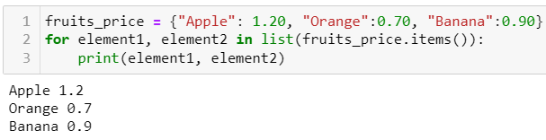
Example of printing dictionary items
Printing the items of our fruits_price dictionary

Slide 33
Edit Dictionaries
Change a value of a dictionary by assigning a new value to a certain key.
The value can be a numeric value, a character string, a tuple, or a list.
dictionary_name["key"] = value

Slide 34
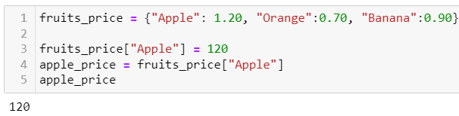
Example of editing dictionary
Let us change the price of Apple from 1.20 to 120.
Verify that the price of Apple is 120 in Fruits_Price.
fruits_price["Apple"] = 120

Slide 35
Change Dictionary Keys
Editing a key in a dictionary is not straightforward.
The keys are immutable and cannot be changed directly.
Instead, we can create a new key in a dictionary, take over the values from the old key, and then delete the old key.
The syntax del deletes an object in Python, including a dictionary key.
Once an object is deleted, it will no longer be available in the program.
del object

Slide 36


Example of deleting
Delete the key, Apple, in fruits_price
Verify the key, Apple, is deleted from fruits_price

Slide 37

Add Items to Dictionary
To add a dictionary key, we simply assign a value to a new key.
The syntax is just the same as the syntax to edit an existing key.
The only difference is that the key in the index operator must be a new one here, and an existing one for editing.
dictionary_name["new key"] = value

Slide 38
Merge Dictionaries
To merge two dictionaries, Python offers two options.
Syntax for Python version 3.9 onwards uses the “Bitwise Or” operator “|” to merge two dictionaries:
Syntax for Python version 3.5 onwards:
new_dictionary = dictionary1 | dictionary2
new_dictionary = {**dictionary1, **dictionary2}

Slide 39
Example Program for Students
Create one dictionary: Keys—The names of three people; Values—The ages of the three people
Print the keys of the dictionary
Print the values of the dictionary
Extract all keys and values of the dictionary at the same time
Print dictionary items line by line with for loops

Slide 40
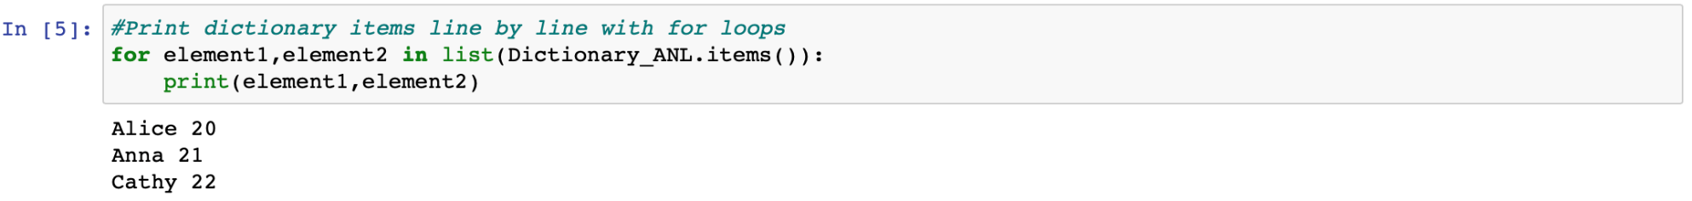
Example Program (answers)
Create one dictionary: Keys—The names of three people; Values—The ages of the three people
Print the keys of the dictionary
Print the values of the dictionary
Extract all keys and values of the dictionary at the same time
Print dictionary items line by line with for loops

Slide 41
Example Program for Students
Modify the value of the middle item in the dictionary
Delete the middle item in the dictionary
Add another item ('name':age) to the dictionary
Create a new ('name':age) dictionary with two items
Merge the two dictionaries

Slide 42
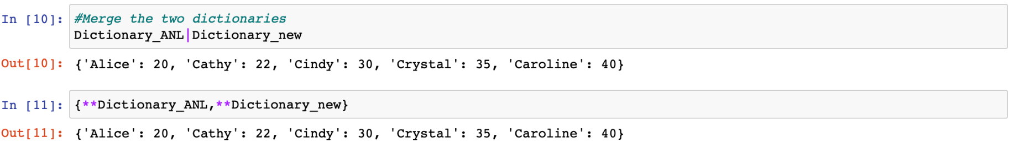
Example Program (answers)
Modify the value of the middle item in the dictionary
Delete the middle item in the dictionary
Add another item ('name':age) to the dictionary
Create a new ('name':age) dictionary with two items
Merge the two dictionaries

Slide 43
Integrated Methods and Functions

Slide 44
Functions
Functions are routine programs for value processing.
Values are passed on to functions as arguments/parameters and results will be returned as output to the user.
E.g., int() removes all decimal digits of a value and returns an integer as result.

Slide 45
Built-In Functions
Built-in functions are integrated in Python, e.g., print(), input().
Here is a list of all Python built-in functions in alphabetical order.
(Source: https://docs.python.org/3/library/functions.html)
abs() | all() | any() | ascii() | bin()
bool() | breakpoint() | bytearray() | bytes() | callable()
chr() | classmethod() | compile() | complex() | delattr()
dict() | dir() | divmod() | enumerate() | eval()
exec() | filter() | float() | format() | frozenset()
getattr() | globals() | hasattr() | hash() | help()
hex() | id() | input() | int() | isinstance()
issubclass() | iter() | len() | list() | locals()
map() | max() | memoryview() | min() | next()
object() | oct() | open() | ord() | pow()
print() | property() | range() | repr() | reversed()
round() | set() | setattr() | slice() | sorted()
staticmethod() | str() | sum() | super() | tuple()
type() | vars() | zip() | __import__()

Slide 46
Built-In Methods in Python
Methods are routines that are applied to the objects they are attached to.
E.g., .format() for formatting string, .keys(), .values() and .items() for dictionaries.
Methods return results to the program once they are applied on defined objects during runtime.
Each method is only applicable to certain object types.
The list of some common methods can be found on:
https://www.w3schools.com/python/python_ref_tuple.asp https://www.w3schools.com/python/python_ref_list.asp https://www.w3schools.com/python/python_ref_dictionary.asp https://www.w3schools.com/python/python_ref_string.asp

Slide 47
Discussion
How can we get the information on the components of a built-in function or method before applying them in our program?
Can we avoid the use of functions or methods and write such routines by ourselves?

Slide 48
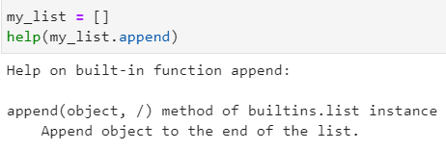
Discussion (answer)
How can we get the information on the components of a built-in function or method before applying them in our program?
Use the help() command
Can we avoid the use of functions or methods and write such routines by ourselves?
user-written functions

Slide 49
User-Defined Functions
User-defined functions are functions that we write to suit our own needs.
They will only be executed when they are called from the main program.
A function usually consists of four parts:
Function name
Arguments
Instructions
Output object (or value)

Slide 50
Correct Use of User-Defined Functions
No “outsourcing” of main program parts to functions because of “program cleanliness”.
Debugging is challenging if the code jumps between main program and functions.
Rules of thumb for using user-defined functions:
Same routine appears more than once in main program.
Combination of various functions is used on multiple occasions.
Increase of main program’s efficiency.

Slide 51
Syntax of User-Defined Functions
The def-syntax indicates the definition of a function:
Functions are called in the main program by integrating the function name with the arguments at an appropriate place.
def function_name(argument1, argument2, …):
instructions
return object
… (Main program)
y = function_name(argument1 = object1, argument2 = object2, …)
print(y)
… (Continue with main program)

Slide 52
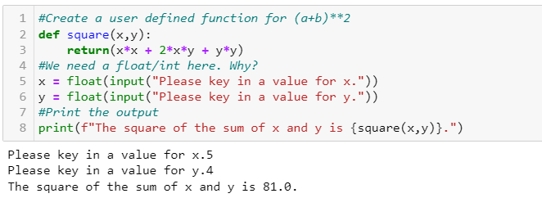
Example: user-defined functions

Slide 53
Example Program for Students
Please write user-defined functions that enable users to perform addition, subtraction, multiplication, and division with two input integers.
Call the user-defined functions in your main programme and display the results.

Slide 54
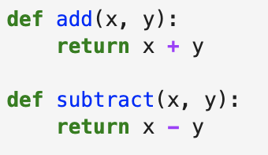
Example Program (Answers)
Hints: Partial program—Perform addition, subtraction

Slide 55
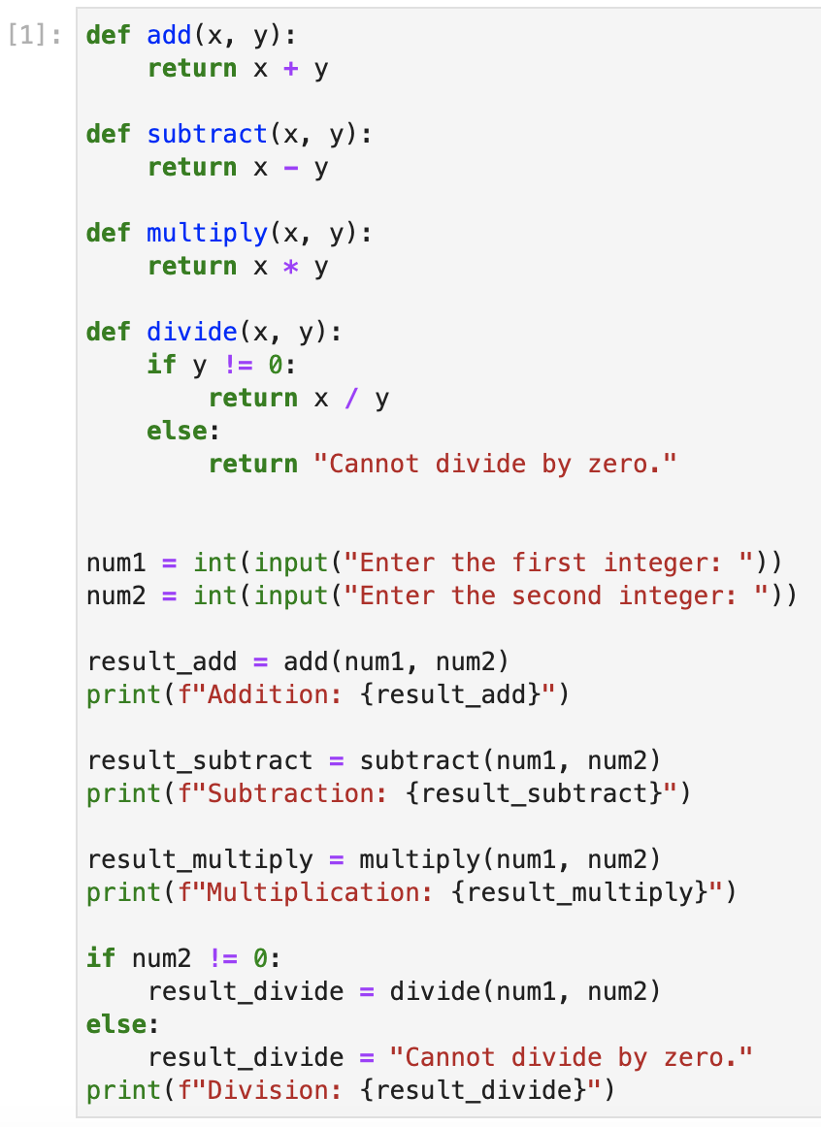
Example Program (Answers)
Full Answer:

Slide 56
Discussion
When is it appropriate for us to write a user-defined function?

Slide 57
Discussion (answers)
When is it appropriate for us to write a user-defined function?
E.g., break very complex codes into chunks

Slide 58
Modules, Packages and Libraries (This section is for your information only because you are using Anaconda3)

Slide 59
Modules, Packages, Libraries
Python packages are like directories of Python scripts, or modules.
Modules specify functions, methods, and object types to solve certain tasks.
Packages may contain sub-packages or regular modules.
Packages of standard libraries are already installed in Python.
Library is a collection of codes to perform specific tasks without writing our own code.

Slide 60
Import Packages and Modules
In Python, we can choose to import the entire package or a specific module of the package.
Use an alias to refer to a specific package or module from thereon in the program.
Alias is advantageous if the package or module has a very long name.
import package_name as package_alias
from package_name import module_name as module_alias

Slide 61
Install Packages with pip/pip3
More Python packages are available on the internet.
Download and install them by the pip or pip3 Python package.
Use PowerShell or Command Prompt as well (or similar terminal apps from other operation systems) to execute the following command:
“pip3” is a newer version of “pip”. Use either one for the installation.
> pip install package_name
> pip3 install package_name

Slide 62
Upgrade and Uninstall Packages
To update/upgrade a package, we need to type the following syntax in the terminal apps.
Uninstall a package by the command:
> pip install package_name --upgrade
> pip3 install package_name --upgrade
> pip uninstall package_name
> pip3 uninstall package_name

Slide 63
Common Packages in Python
Here are some common packages for data analytics in Python.
Package | Description
matplotlib | Creates data visualisation
NumPy | Manages multi-dimensional arrays
pandas | Handles two-dimensional data tables
pendulum | Provides complex coding for dates and times
requests | Sends HTTP requests from Python code
scikit-learn | Provides tools of data analytics
scipy | Carries out scientific and technical computations
sqlite3 | Manages SQL database in Python

Slide 64
Online Learning Platform (Optional)
Tuple:
https://www.w3schools.com/python/python_tuples.asp
List:
https://www.w3schools.com/python/python_lists.asp
Dictionary:
https://www.w3schools.com/python/python_dictionaries.asp
Functions:
https://www.w3schools.com/python/python_dictionaries.asp

